Slide 1
Markdown and Web

Slide 2
Web pages
A web page is simply a text file with extra information on display rules
A web browser reads the text file and locates the display rules
It then applies the display rules to the enclosed text
Display rules can be simple (font family, type), or complex (bullets, colors, layout …)

Slide 3
Web page
<!DOCTYPE HTML>
<html>
<head>
<title>Regex: Markdown Conversion</title>
</head>
<body></body>
</html>
The page content goes here …

Slide 4
Web page content can be hard to read …
<div class="card mt-2">
<div class="card-header">
Submission
</div>
<div class="card-body">
<li>Submit your code to a directory named <i>regex_md</i> in your git repository.</li>
<h3>Grading scheme: 100 points</h3>
<ul>
<li>Clean build (10)</li>
<li>Proper use of regex(20)</li>
<li>Full/ correct conversion of Markdown file to HTML (70)</li>
</ul>
</div>
</div>

Slide 5
Web page generators
Web page generators allow you to ‘create’ a web page as a more normal text file (with simplified instructions for formatting)
The generator then takes the ‘normal’ text file format and generates an HTML file
One such approach is using Markdown files and converting to HTML
NOTE:
Hypertext Markup Language
And
……………. Markdown …….

Slide 6
How it works …
In markdown, certain characters tell the display engine how to render (present) the text
In HTML, ‘tags’ are used (in conjunction with styles) to do the same thing
  We will just use different tags for this assignment
  e.g.
Markdown | Markdown 'rule' | HTML
# Heading level 1 | Line starts with # | <h1>Heading level 1</h1>
## Heading level 2 | Line starts with ## | <h2>Heading level 2</h2>
### Heading level 3 | Line starts with ### | <h3>Heading level 3</h3>
**Bold** | There are two asterisks followed by alphanumerics, followed by two asterisks | <strong>Bold text</strong> OR <b>Bold text</b>
_Italics_ | There is an underscore followed by alphanumerics, followed by an underscore | <i>Italicized text</i>
>Block quote (aligned/ block of text) | Line starts with > (The text after the '>' will be aligned in a block until an empty line is found) | <blockquote>Block quote (aligned/ block of text)</blockquote>

Slide 7
Assignment …
You will read in a markdown file and generate a valid html file (webpage)
We will use gitlab to publish your webpage … and you can see the results of your work!
You will use regex in C++ to accomplish this!

Slide 8
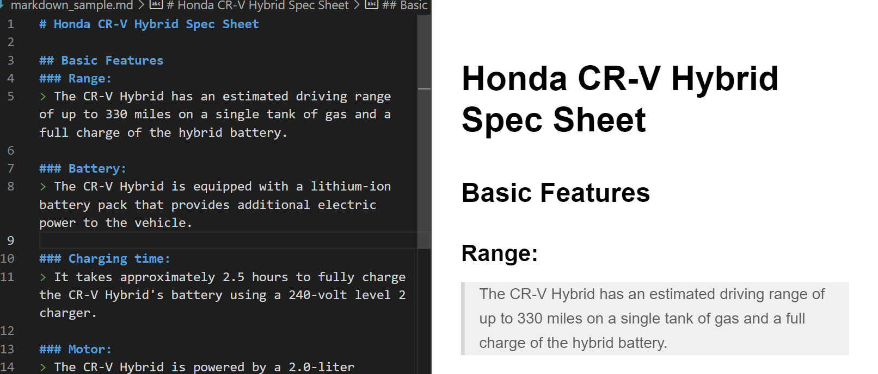
Markdown intent

Slide 9
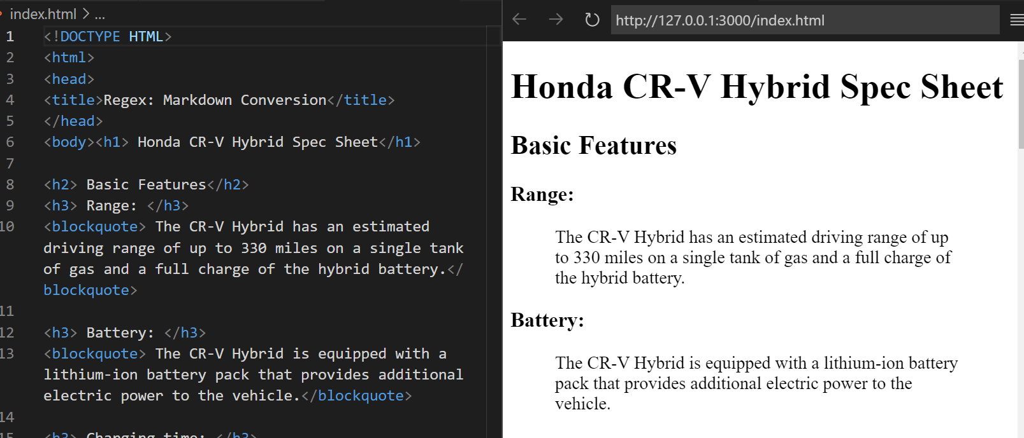
Webpage version

